Slide 1
FROM THE CODE OF ETHICS FOR RESEARCH WORKERS…
03.06.2019
Anna Mietelska-Porowska

Slide 2
FROM THE CODE OF ETHICS FOR RESEARCH WORKERS:
Problems of co-authorship in scientific reports

Slide 3
FROM THE CODE OF ETHICS FOR RESEARCH WORKERS:
Problems of co-authorship in scientific reports
Research Integrity

Slide 4
FROM THE CODE OF ETHICS FOR RESEARCH WORKERS:
Problems of co-authorship in scientific reports
In 1997, the "New England Journal of Medicine" published "Uniform Requirements for Manuscripts Submitted to Biomedical Journals"
Uniform Requirements for Manuscripts Submitted to Biomedical Journals define officially set rules for manuscript printing and co-authoring (so-called Vancouver rules).
Vancouver rules have been set by the International Committee of Medical Journal Editors
and apply to all Philadelphia list journals.

Slide 5
FROM THE CODE OF ETHICS FOR RESEARCH WORKERS:
Problems of co-authorship in scientific reports
The Philadelphia List - a Polish term for a ministerial (Ministry of Science and Higher Education) list of scientific journals that have undergone an evaluation process and are included in Institute for Scientific Information (ISI) databases.
The name Philadelphia List was introduced by Andrzej Kajetan Wróblewski
This term is often misused to describe a list of journals that have a calculated Impact factor (IF). IFs are given once a year in the Journal Citation Reports (JCR) database maintained by the ISI.
In other countries, the equivalent of the Philadelphia List is the ISI Master Journal List
The list of journals (obligatory for us) ranked by the Ministry of Science and Higher Education is based on the Philadelphia List.
- list of scientific journals that are taken into account in the parametric assessment of scientific institutions, universities, institutes, research and development units financed by the Ministry of Science and Higher Education.
The current list was published on 26 January 2017[Wykaz czasopism naukowych zawierający historię czasopisma z publikowanych wykazów za lata 2013-2016. MNiSW, 26 stycznia 2017. [dostęp 2017-10-30].. http://www.bip.nauka.gov.pl/wykaz-czasopism-naukowych/
Parametric assessment takes into account the scientific achievements of the unit, among other things on the basis of the number of points awarded to publications written by the employees of the unit.

Slide 6
FROM THE CODE OF ETHICS FOR RESEARCH WORKERS:
Problems of co-authorship in scientific reports
Vancouver rules
the authorship of the article should be supported by a significant contribution in:
● formulating conception and design of the work or analysis and interpretation of data;
● writing the draft version of the article or revising it for intellectually important content;
● working on the final, ready to be published version of the manuscript.
These three criteria must be met jointly:
At least one of the co-authors must be accountable for each part of the work necessary to prepare the applications.
The following does NOT entitle one to be acknowledged as the co-author of the work:
participation limited to providing research financing only
technical participation and data collection
general supervision of the research group
Lack of respect for someone else's intellectual and research efforts and appropriation of another person's thoughts cause the decline of research integrity and weaken individual scientific disciplines.

Slide 7
FROM THE CODE OF ETHICS FOR RESEARCH WORKERS:
Problems of co-authorship in scientific reports
International Committee of Medical Journal Editors (ICMJE),
(Vancouver group)
Acknowledgements:
Most journals allow (or even encourage) the recognition of the contributions to the research project of persons who do not meet the above-mentioned criteria for recognition.
The ICMJE guidelines state:
"All others who contributed to the work, who are not authors, should be disclosed as acknowledgements, and what they did should be described.”
All those mentioned in this way need to be aware of this.
Some journals (mainly in the USA) will also require the signatures/statements of the people listed in the Acknowledgements.

Slide 8
FROM THE CODE OF ETHICS FOR RESEARCH WORKERS:
Problems of co-authorship in scientific reports
CATEGORIES AND RULES OF CO-AUTHORSHIP
Corresponding author:
The person responsible for the entire publication sent to print, who receives and responds to the comments of the reviewers. The contact details of this person are printed on the article so that readers can also ask for reprints or contact the research group.
The corresponding author is identified with seniority, usually the head of the research group or research unit (head of the team), but this may be any of the co-authors, determined by the consent of all, with sufficient knowledge to take on this role.
Journal editors see this as a purely administrative role.

Slide 9
FROM THE CODE OF ETHICS FOR RESEARCH WORKERS:
Problems of co-authorship in scientific reports
CATEGORIES AND RULES OF CO-AUTHORSHIP
Corresponding author:
The person responsible for the entire publication sent to print, who receives and responds to the comments of the reviewers. The contact details of this person are printed on the article so that readers can also ask for reprints or contact the research group.
The corresponding author is identified with seniority, usually the head of the research group or unit (head of the team), but this may be any of the co-authors, determined by the consent of all, with sufficient knowledge to take on this role.
Journal editors see this as a purely administrative role.
First and last authors:
The first author is the person who has contributed the most to the published research (mainly in terms of content).
The criteria determining the meaning of the last author vary.
Most often it is a member of a senior team that has contributed to the expertise and guidance, usually the head of a research group or unit (head of the team). This is consistent with the ICMJE criteria only if this person was involved in designing research and/or interpretation of the data and has critically reviewed the publication.

Slide 10
FROM THE CODE OF ETHICS FOR RESEARCH WORKERS:
Problems of co-authorship in scientific reports
CATEGORIES AND RULES OF CO-AUTHORSHIP
Corresponding author:
The person responsible for the entire publication sent to print, who receives and responds to the comments of the reviewers. The contact details of this person are printed on the article so that readers can also ask for reprints or contact the research group.
The corresponding author is identified with seniority, usually the head of the research group or research unit (head of the team), but this may be any of the co-authors, determined by the consent of all, with sufficient knowledge to take on this role.
Journal editors see this as a purely administrative role.
First and last authors:
The first author is the person who has contributed the most to the published research (mainly in terms of content).
The criteria determining the meaning of the last author vary.
Most often it is a member of a senior team that has contributed to the expertise and guidance, usually the head of a research group or unit (head of the team). This is consistent with the ICMJE criteria only if this person was involved in designing research and/or interpretation of the data and has critically reviewed the publication.
Group authorship:
Some journals allow the use of group names, but many require that co-authors are listed (often alphabetically) and/or the writing group is also to be named. One problem with group names is that they are often miscoded in databases such as Medline. The first person on the alphabetical list of collaborators becomes the first author by default, which distorts the actual manuscript authorship.

Slide 11
FROM THE CODE OF ETHICS FOR RESEARCH WORKERS:
Problems of co-authorship in scientific reports
CATEGORIES AND RULES OF CO-AUTHORSHIP
Order of authors:
The other co-authors are usually listed in order of their contribution (primarily in terms of content) to the published manuscript.
The ICMJE guidelines state that the order of authors should be "a joint decision by the co-authors. Each author should be prepared to clarify the order of authors".
Wherever possible, decisions should be made on the order of listing the co-authors before writing the project.
In a situation where authors have made an equal contribution to the research and publication (e.g., equally first authors), the authors should be listed in alphabetical order and an explanatory note should be included, clearly drawn up for the editor.

Slide 12
FROM THE CODE OF ETHICS FOR RESEARCH WORKERS:
Problems of co-authorship in scientific reports
CATEGORIES AND RULES OF CO-AUTHORSHIP
Order of authors:
The other co-authors are usually listed in order of their contribution (primarily in terms of content) to the published manuscript.
The ICMJE guidelines state that the order of authors should be "a joint decision by the co-authors. Each author should be prepared to clarify the order of authors".
Wherever possible, decisions should be made on the order of listing the co-authors before writing the project.
In a situation where authors have made an equal contribution to the research and publication (e.g., equally first authors), the authors should be listed in alphabetical order and an explanatory note should be included, clearly drawn up for the editor.
Number of authors:
The ICMJE does not establish principles on this subject.
In the past, databases such as Medline have limited the number of authors listed. This has been shown to have an impact on the number of authors (most groups have tried to stay below the limit), and in larger groups it has probably increased a race for positions. Currently, most databases recommend listing all authors who meet the criteria (Vancouver rules).

Slide 13
FROM THE CODE OF ETHICS FOR RESEARCH WORKERS:
Problems of co-authorship in scientific reports
CATEGORIES AND RULES OF CO-AUTHORSHIP
"Should we expect a radiologist to explain statistical methods
or a statistician to interpret X-rays?"
It is important that the scope of work undertaken by a particular co-author corresponds to his/her actual area of expertise, as the author is responsible for the content attributed to him/her.
Given the growing expertise, the ICMJE guidelines consider it unjustified to ask natural persons to take responsibility for every aspect of research.
The ICMJE guidelines consider it important that one person ensures the integrity of the entire project - Guarantor
"All persons designated as authors should meet the authorship criteria (according to Vancouver rules) and all those who qualify should be listed.
Each author should be sufficiently involved in work in order to take public responsibility for the right parts of the content.
One or more (decided by all) authors should
take responsibility for the integrity of the work as a whole,
from the beginning to the publication of the article."

Slide 14
FROM THE CODE OF ETHICS FOR RESEARCH WORKERS:
Problems of co-authorship in scientific reports
PROHIBITED PRACTICES
Ghost authors:
This term is used in two cases:
It usually refers to professional writers (often paid by commercial sponsors) whose role is not recognized. Such authors do not meet the ICMJE criteria because they are not involved in research design, data collection or interpretation. Their involvement may constitute a potential conflict of interest.
The term may also be used to describe persons who have made a significant contribution to the research project and meet the ICMJE criteria but are not listed as authors. The ICMJE guidelines explicitly condemn this practice and state that "all persons designated as authors should be eligible for authorship, and all those who qualify should be listed".

Slide 15
FROM THE CODE OF ETHICS FOR RESEARCH WORKERS:
Problems of co-authorship in scientific reports
PROHIBITED PRACTICES
Ghost authors:
This term is used in two cases:
It usually refers to professional writers (often paid by commercial sponsors) whose role is not recognized. Such authors do not meet the ICMJE criteria because they are not involved in research design, data collection or interpretation. Their involvement may constitute a potential conflict of interest.
The term may also be used to describe persons who have made a significant contribution to the research project and meet the ICMJE criteria but are not listed as authors. The ICMJE guidelines explicitly condemn this practice and state that "all persons designated as authors should be eligible for authorship, and all those who qualify should be listed".
Gift/Honorary authors:
Individuals listed as authors but who do not contribute significantly to the research and therefore do not meet the ICMJE criteria.
These are often people who have more seniority in the hierarchy of the institution (e.g. heads of departments), whose names are added out of favour, because of the potential benefits for the success of the publication of the work arising from such person's acknowledged achievements or because we are expected to do so.
A colleague whose name has been added on the assumption that he/she will do the same for you, regardless of your contribution to his/her research, in order to add to each other's lists of publications in the scientific achievements.

Slide 16
FROM THE CODE OF ETHICS FOR RESEARCH WORKERS:
Problems of co-authorship in scientific reports
COPYRIGHT
Journal of Laws of 1994, No. 24, Item 83
ACT
of 4 February 1994
on Copyrights and Related Rights
selected issues
Nencki Institute of Experimental Biology PAS
LEGAL REGULATION OF PUBLISHED RESEARCH RESULTS
Available: intra.nencki.gov.pl

Slide 17
FROM THE CODE OF ETHICS FOR RESEARCH WORKERS:
Problems of co-authorship in scientific reports
Ministry of Science and Higher Education
„Scientific works are very often the result of the work of not one, but many people. Their contribution to the creation of a work (for example, an article) may be different, both in qualitative and quantitative terms.
Cooperation in the creation of a scientific work does not always mean co-authorship.
Co-authorship, however, can mean both, significant and relatively small creative contribution.
The team preparing the work for publication, and especially the person responsible to the publisher for the entire work (correspondent author, guarantor) and representing all co-authors, should comply with the following rules:
The principle of obedience to the law
Principle of justice
The principle of truthfulness and openness
„Rzetelność w badaniach naukowych oraz poszanowanie własności intelektualnej”(Research Integrity and Intellectual Property Potection). www.nauka.gov.pl

Slide 18
FROM THE CODE OF ETHICS FOR RESEARCH WORKERS:
Problems of co-authorship in scientific reports
Ministry of Science and Higher Education
The principle of obedience to the law
Article 8 (it is said that the author of the work is its creator) and Article 16 (specifies the subject of personal copyrights) of the Act of 4 February 1994 on Copyrights and Related Rights
(consolidated text: Journal of Laws of 2006 No. 90, item 631, as amended).
Polish law does not deprive anyone of copyrights who has made even the most modest, but independent and creative contribution to the creation of the work. A co-author is therefore anyone who wrote even a small part of it, made any creative contribution to its conception or composition, took part in research designing that resulted in a given work.
„Rzetelność w badaniach naukowych oraz poszanowanie własności intelektualnej”(Research Integrity and Intellectual Property Potection). www.nauka.gov.pl

Slide 19
FROM THE CODE OF ETHICS FOR RESEARCH WORKERS:
Problems of co-authorship in scientific reports
Ministry of Science and Higher Education
2. Principle of justice
„Justice and honesty require that every person who contributed to the creation of the work is noticed and appreciated.
Very often, apart from the authors, there are other people without the contribution of whom the work would not be created or would not reach the final scientific level.
These people are colleagues, sometimes superiors, as well as mentors or advisors.
It is good practice to indicate the contribution to the creation of a work in the form of the acknowledgements or the editorial information, which briefly states who and how contributed to the creation of the work in its final form.
Such information should include not only persons (cooperating on an honorary or remunerative basis) but also institutions.”
„The person responsible for contact with the publishing company (corresponding author) should make every effort to include in the content of the publication the information about the scope of work of individual co-authors and co-workers.”
„It is also very important to distinguish the main author of the work, identified by placing his name in the first place among co-authors of a scientific publication, from the person taking responsibility for contact between the team of authors and the publisher (corresponding author).
The co-author listed first is the person who, regardless of his or her position and scientific status, has made by far the greatest creative contribution to the work.
Politeness, especially opportunism, cannot be expressed by the untruthfulness of the authorship of scientific publications.
„Rzetelność w badaniach naukowych oraz poszanowanie własności intelektualnej”(Research Integrity and Intellectual Property Potection). www.nauka.gov.pl

Slide 20
FROM THE CODE OF ETHICS FOR RESEARCH WORKERS:
Problems of co-authorship in scientific reports
Ministry of Science and Higher Education
3. The principle of truthfulness and openness
The attribution of authorship must be consistent with the reality.
It is not acceptable to:
add persons who are not actual co-authors of the work to the authors' team (e.g. out of politeness or in order to give the publication greater prestige).
to omit co-authors and not to include their names in the publication.
Such conduct may constitute an offence (Article 115, Section 1 of the Act of 4 February 1994 on Copyrights and Related Rights [consolidated text: Journal of Laws of 2006 No. 90, item 631, as amended].
The truthful and complete attribution of authorship is one of the conditions for its scientific credibility.
The scientific community has the right to know who created the work and who is responsible for its content.
When editing footnotes, the rule applies that the information given clearly indicates where the used (quoted) or referred excerpt comes from.
It is unacceptable to ignore the fact that the source of the used (quoted) or referred excerpt is the publication of another author, not the original text.
The attribution of authorship provides an opportunity for numerous wrongdoings, which most often result in people who have a very small contribution to the creation of a work to gain disproportionate benefits in the form of a large number of points in the verification procedures.
„Rzetelność w badaniach naukowych oraz poszanowanie własności intelektualnej”(Research Integrity and Intellectual Property Potection). www.nauka.gov.pl

Slide 21
FROM THE CODE OF ETHICS FOR RESEARCH WORKERS:
Problems of co-authorship in scientific reports
Polish Academy of Sciences (PAS)
Authorship must be based solely on substantial intellectual contribution to the research. This includes significant contribution in initiating scientific idea, formulating conceptions, designing research, significant share in data acquisition, in the analysis and interpretations of data and in drafting the article or revising it critically for intellectual content.
Acquisition of funding, provision of equipment and training in its use, the collection of data, and general supervision of the research group, by themselves, do NOT justify authorship.
All authors are fully responsible for the content of the publication, unless otherwise specified (e.g. they are responsible only for a specific part of the research within their area of expertise). When listing authors and their affiliations, it is appropriate to mention what was the nature of their contributions.
Sequence of authors should be consistent with the existing customs in a given scientific discipline and agreed by all co-authors at the start of the publication.
Intellectual contributions of others, who have a significant influence on the published research should be appropriately acknowledged.
"Code of Ethics for Research Workers", Science Ethics Committee, PAS, 2017

Slide 22
FROM THE CODE OF ETHICS FOR RESEARCH WORKERS:
Problems of co-authorship in scientific reports
National Science Centre
1.4. Authorship
The authorship of scientific publications reflects the contribution to the development of the publication. Scientific works can have one or more authors.
However, cooperation in the development of the work does not tantamount to co-authorship.
Issues of authorship are regulated by the Act of 4 February 1994 on Copyrights and Related Rights
[Act of 4 February 1994 on Copyrights and Related Rights, consolidated text: Journal of Laws of 2006, No. 90, Item 631, as amended].
It should be emphasized that Polish law does not deprive of copyright anyone who makes even the most modest, but independent and creative contribution to the development of the work [Rzetelność w badaniach naukowych oraz poszanowanie własności intelektualnej, (Research Integrity and Intellectual Property Potection), MNiSW, Warszawa 2012].
Responsibilities
Participation in co-creation of a work (co-authorship) should take into account the following four criteria laid down in the Vancouver guidelines [International Committee of Medical Journal Editors, Recommendations for the Conduct, Reporting, Editing and Publication of Scholarly Work in Medical Journals, updated in December 2015],
and everybody who meets them should be considered a co-author of a research work.
These criteria must be met jointly:
substantial contribution to the conception or design of the work; or the acquisition, analysis and interpretation of data for the work
drafting the work for publication and revising it or making critical comments on the content and experimental part
final approval of the version to be published
agreement to be accountable for all aspects of the work in ensuring that any questions or ambiguities related to the accuracy or integrity of any part of the work are appropriately investigated and resolved.
”The Code of the National Science Centre on Research Integrity and Applying for Research Financing”

Slide 23
FROM THE CODE OF ETHICS FOR RESEARCH WORKERS:
Problems of co-authorship in scientific reports
International Committee of Medical Journal Editors (ICMJE),
(also known as the Vancouver group)
Misrepresentation is a form of research misconduct, and honesty in reporting science should extend to authorship.
If scientists are dishonest about their relationship to their work, this undermines confidence in the reporting of the work itself.
How to handle authorship disputes: a guide for new researchers
Tim Albert, trainer in medical writing,
Elizabeth Wager, freelance writer and trainer
The COPE Report 2003

Slide 24
FROM THE CODE OF ETHICS FOR RESEARCH WORKERS:
Problems of co-authorship in scientific reports
Research Integrity

Slide 25
FROM THE CODE OF ETHICS FOR RESEARCH WORKERS:
Research Integrity
The fundamental principles of research integrity, or responsible conduct of research, according to the Singapore Statement on Research Integrity:
1. Honesty in all aspects of research
2. Accountability in the conduct of research
3. Professional courtesy and fairness in working with others
4. Good stewardship of research on behalf of others
Source:
https://www.embo.org/science-policy/research-integrity

Slide 26
FROM THE CODE OF ETHICS FOR RESEARCH WORKERS:
Research Integrity
Resolution No. 3/2016
the General Assembly of the Polish Academy of Sciences of 1 December 2016
on the Code of Ethics for Research Workers
Basic, universal principles and ethical values on which the integrity and credibility of science is based relate to the representatives of all scientific disciplines, without exception.
Researchers, institutions where they conduct research, funding agencies and other bodies that help scientific community to connect openly with each other and the outside world should adhere to these principles.
"Code of Ethics for Research Workers", Science Ethics Committee, PAS, 2017

Slide 27
FROM THE CODE OF ETHICS FOR RESEARCH WORKERS:
Research Integrity
The universal principles on which the integrity and credibility of science is based include:
1) conscientiousness in: presenting goals and intentions of planed or performer research, presenting research methods and procedures as well as interpretations of obtained results, providing information on possible threats, anticipated benefits and practical applications;
2) credibility in conducting research, criticism towards one’s own results, meticulousness, attention to detail and great care in presenting research results;
3) not using scientific authority when speaking on topics from outside one’s area of competence;
4) objectivity: interpretations and conclusions must be founded on facts, verifiable reasoning, and data capable of proof and secondary review;
5) independence from commissioning or interested parties (free from any external influence), from political, ideological and economic pressure groups;
6) openness in discussions with other scientists on their own research, which is one of the key conditions for progress in science, contributing to public knowledge through publication of the findings, honest communication to the general public;
7) transparency in the handling of research data that guarantees data and materials availability after publication;
8) duty of care for the participants and the subjects of research; research on living creatures should only be conducted where necessary (with the consent of the appropriate bioethics commissions) and should always rest on the principles of respect for human dignity and animal rights;
9) fairness and reliability in: evaluating works of other researchers, giving credit where credit is due by providing correct citation and reference information;
10) courage to oppose views that are contrary to scientific knowledge and practices incompatible with the principles of scientific reliability;
11) concern for future science generations manifested through giving young researchers opportunity to develop their scientific skills and instilling in them binding standards and ethical norms.
"Code of Ethics for Research Workers", Science Ethics Committee, PAS, 2017

Slide 28
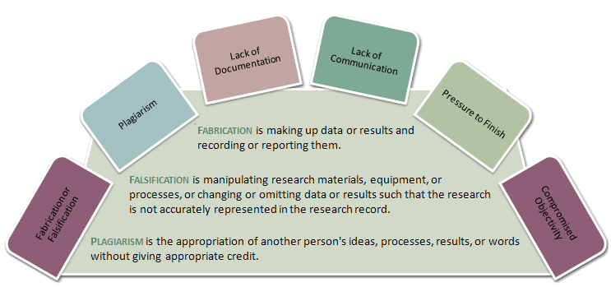
FROM THE CODE OF ETHICS FOR RESEARCH WORKERS:
Research Integrity
The most serious forms of research misconduct that especially damage the ethos of science and violate fundamental principles of scientific integrity:
1. Fabrication involves making up results and recording them as if they were real.
2. Falsification involves changing or omitting unwelcome data, so that research results are not accurately represented.
3. Plagiarism is the appropriation of another person’s ideas, research results or words without giving appropriate credit; this action constitutes a violation of intellectual property rights.
"Code of Ethics for Research Workers", Science Ethics Committee, PAS, 2017

Slide 29
FROM THE CODE OF ETHICS FOR RESEARCH WORKERS:
Research Integrity
OTHER TYPES OF RESEARCH MISCONDUCT
Apart from serious violations of research integrity there are many other forms of academic misconduct in research.
List of inappropriate scientific behaviour cannot be closed.
However, the following should be mentioned:
using other people's contributions in the conduct of scientific research without adequate financial compensation or sufficient acknowledgement of contributors,
granting co-authorship to an individual who did not contribute intellectually enough to the publication,
consent to carry out research in an ostensible manner that has nothing in common with scientific integrity,
unjustified quoting of works of others or one’s own or deliberate omitting of citations,
all forms of oppression and discrimination against students and co-workers,
misuse of research funds and concealment of conflicts of interest,
nepotism in hiring new employees.
"Code of Ethics for Research Workers", Science Ethics Committee, PAS, 2017

Slide 30
FROM THE CODE OF ETHICS FOR RESEARCH WORKERS:
Research Integrity
These violations may occur at different stages, when:
submitting a research proposal,
applying for funding,
performing and reviewing research,
presenting research findings during scientific conferences,
publishing,
reporting of other researcher’s results, reporting of expert opinion,
in the public dissemination of science.
Persons found to have committed these violations
may be disqualified from research community.
The responsibility for promoting and adhering to good research practice is shared by the whole research community, including participants of the research process, scientific institutions, and governmental and non-governmental organisations operating within the field of science.
"Code of Ethics for Research Workers", Science Ethics Committee, PAS, 2017

Slide 31

FROM THE CODE OF ETHICS FOR RESEARCH WORKERS:
Research Integrity
Authors have papers in Nature and Science retracted on the same day
RETRACTED
The Science paper has been cited 240 times, according to Clarivate Analytics’ Web of Science.
Its retraction notice reads: After an investigation, the University of Cambridge has concluded that there was falsification of research data used in the Report “Human SIRT6 promotes DNA end resection through CtIP deacetylation” (1), which was the subject of an Editorial Expression of Concern in September 2018 (2). The investigation concluded that the first author, Abderrahmane Kaidi, was responsible for the falsification of the data. In agreement with the recommendation of the investigation, the authors are retracting the Report.
The Nature paper, has been cited 119 times.
Its retraction notice reads: The authors are retracting this Article “KAT5 tyrosine phosphorylation couples chromatin sensing to ATM signalling,”to correct the scientific literature, owing to issues with figure presentation and underlying data. The authors cannot confirm the results in the affected figures and thus wish to retract the Article in its entirety. Both authors, Abderrahmane Kaidi and Stephen P. Jackson, agree with the Retraction.
https://retractionwatch.com

Slide 32
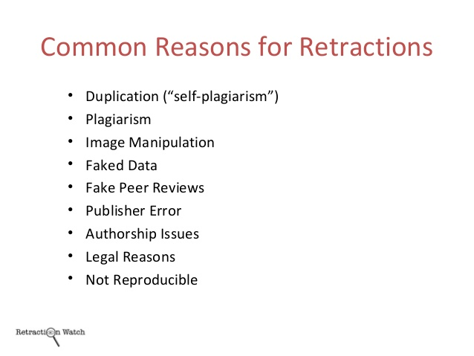
FROM THE CODE OF ETHICS FOR RESEARCH WORKERS:
Research Integrity

Slide 33
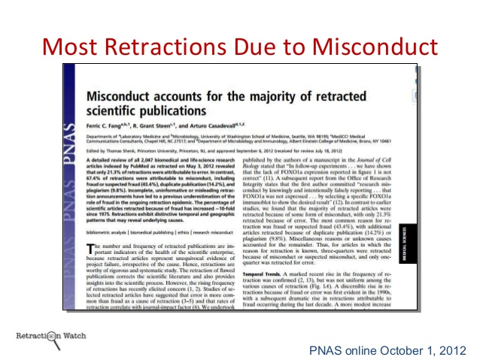
FROM THE CODE OF ETHICS FOR RESEARCH WORKERS:
Research Integrity

Slide 34
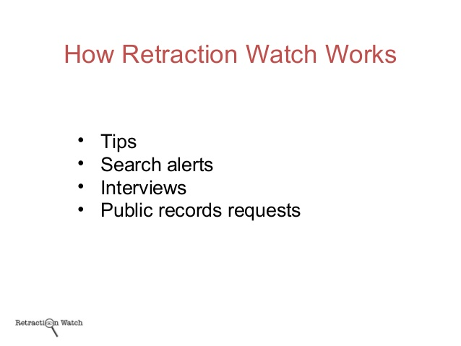
FROM THE CODE OF ETHICS FOR RESEARCH WORKERS:
Research Integrity

Slide 35
FROM THE CODE OF ETHICS FOR RESEARCH WORKERS:
Research Integrity

Slide 36
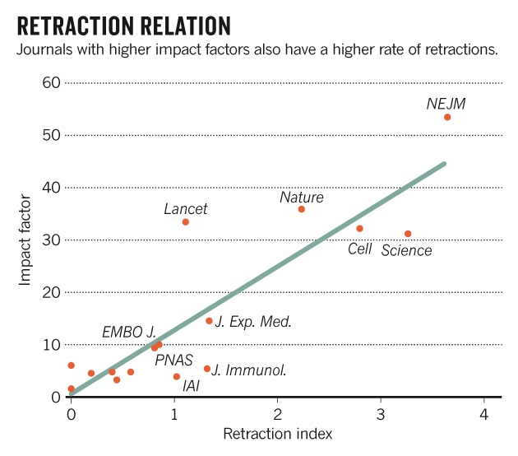
FROM THE CODE OF ETHICS FOR RESEARCH WORKERS:
Research Integrity

Slide 37
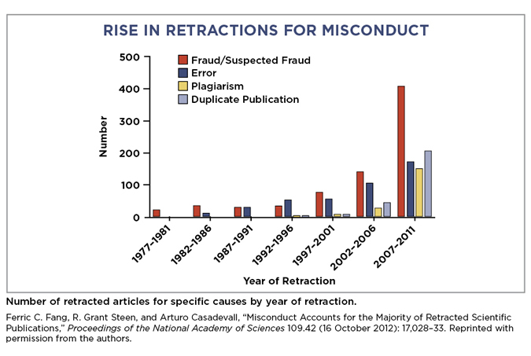
FROM THE CODE OF ETHICS FOR RESEARCH WORKERS:
Research Integrity

Slide 38
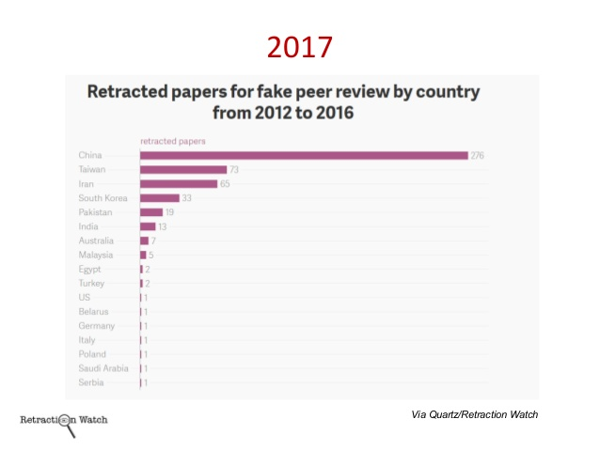
FROM THE CODE OF ETHICS FOR RESEARCH WORKERS:
Research Integrity

Slide 39
Thank you for your attention

